Slide 1
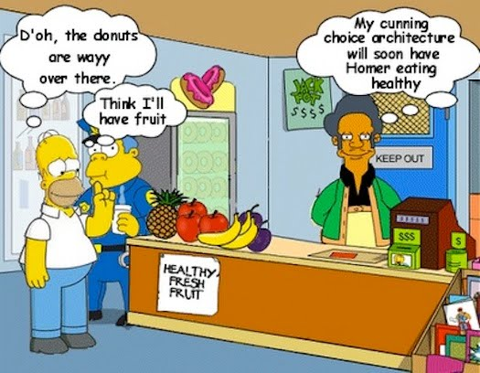

Behavioural Economics

Slide 2

Choice Theory
Utility

Slide 3

Utility
Every individual has certain wants and he consumes commodities which lead to the satisfaction of such wants. It means that the commodities have a capacity to satisfy human wants. Therefore, in general terms, we say that a commodity is useful if it satisfies our want.
In Economics, the want satisfying power of a commodity is called “utility”. Utility is the capacity of a commodity to satisfy particular human want.

Slide 4

Utility versus satisfaction
Also, utility and satisfaction are two different terms but they are inter-related. Utility is pre-consumption and satisfaction is post-consumption. Utility is assumed satisfaction but satisfaction is something that is actually realized.

Slide 5

Historical Evolution of Utility
The assumption that the objective of consumers is expected utility maximization is the most fundamental single component of the standard model, dating back to Jeremy Bentham (1789).
Utility has a hedonic characteristic, which Kahneman (2000), refer to as experienced utility.
Modern economists refer to the utility as ‘decision utility’ which has two advantages over Bentham’s concept:
First, it is easier to measure, since decision utility can be inferred from the choices and actions that people take.
Second, it no longer implies a commitment to a hedonistic philosophy.

Slide 6

Types of Utility
Cardinal and ordinal utility
Decision utility
Experienced utility
Anticipatory utility
Residual utility
Diagnostic utility
Transaction utility

Slide 7
Cardinal and ordinal utility
Cardinal Utility
Utility is measurable in a cardinal sense.
Nineteenth century economists, such as Jevons, Menger and Walras, assumed that utility was measurable in a cardinal sense, which means that the difference between two measurement is itself numerically significant.
U_{X} = f (X), U_{Y} = f (Y), …..
Utility is maximized when:
MU_{X} / MU_{Y} = P_{X} / P_{Y}

Slide 8
Utility
Marginal Utility (MU)
The word Marginal means “Border” or “Edge”.
It is the addition made to the total utility by consuming one more unit of a commodity.
Total Utility (TU)
Total Utility refers to the total satisfaction derived by the consumer from the consumption of a given quantity of a good.
TU = Sum of all MU

Slide 9
Continued….
Ordinal utility
Economists following the lead of Hicks, Slutsky and Pareto believe that utility is measurable in an ordinal sense--the utility derived from consuming a good, such as X, is a function of the quantities of X and Y consumed by a consumer.
U = f ( X, Y )

Slide 10
Continued….
Assumptions of the ordinal utility approach
Complete Ordering;
More is Preferred to Less;
Transitivity or Consistency;
Substitutability or Continuity; and
Optimality

Slide 11
Continued….
Tools used in ordinal approach
The Budget Line
Budget line illustrates the consumer’s income constraint by showing all of the combinations of quantities of X and Y that the consumer can buy.
The Indifference Curves
Indifference curves reveal consumer’s preferences for X and Y by identifying the combinations of X and Y which yield the same level of total utility.

Slide 12
Utility
Characteristics:
Utility is subjective/not measurable
Utility is variable
Utility is different from usefulness
No legal or moral connotations

Slide 13
Calculating Marginal Utility
Number of chocolates per week | Total Utility | Marginal Utility
1 2 3 4 5 6 | 10 25 38 50 59 62 | 15 (25-10) 13 (38-25) 12 (50-38) 9 (59-50) 3 (62-59)

Slide 14
TOTAL UTILITY
MARGINAL UTILITY
Negative marginal utility
Total utility
Total Utility
Marginal Utility
Rising total utility
Diminishing marginal utility
0
1
2
3
4
5
6
0
1
2
3
4
5
6
Quantity
Quantity

Slide 15
Total Utility
TU
X₁ X₂
X
Marginal Utility
MU
X₁ X₂

Slide 16
As long as marginal utility is positive, total utility will increase.
Total and marginal utility can be negative.
Total Utility follows marginal utility.
When marginal utility is zero, total utility is maximized.
This graph demonstrated the Law of Diminishing Marginal Utility.

Slide 17
Law of Diminishing Marginal Utility
Though wants of an individual are unlimited in number yet each individual want is satiable. Because of this, the more we have a commodity, the less we want to have more of it.
This law state that as the amount consumed of a commodity increases, the utility derived by the consumer from the additional units, i.e marginal utility goes on decreasing.
According to Marshall, “The additional benefit a person derives from a given increase of his stock of a thing diminishes with every increase in the stock that he already has”

Slide 18
Law of Diminishing Marginal Utility
Explanation:
As more and more quantity of a commodity is consumed, the intensity if desire decreases and also the utility derived from the additional unit.
Assumptions:
All the units of a commodity must be same in all respects
The unit of the good must be standard
There should be no change in taste during the process of consumption
There must be continuity in consumption
There should be no change in the price of the substitute goods

Slide 19
Utility Derived from Water
Units of Water
Consumed Total Marginal
(8 ounce glass) Utility Utility
0 0 -
1 40 40
2 60 20
3 70 10
4 75 5
5 73 -2

Slide 20
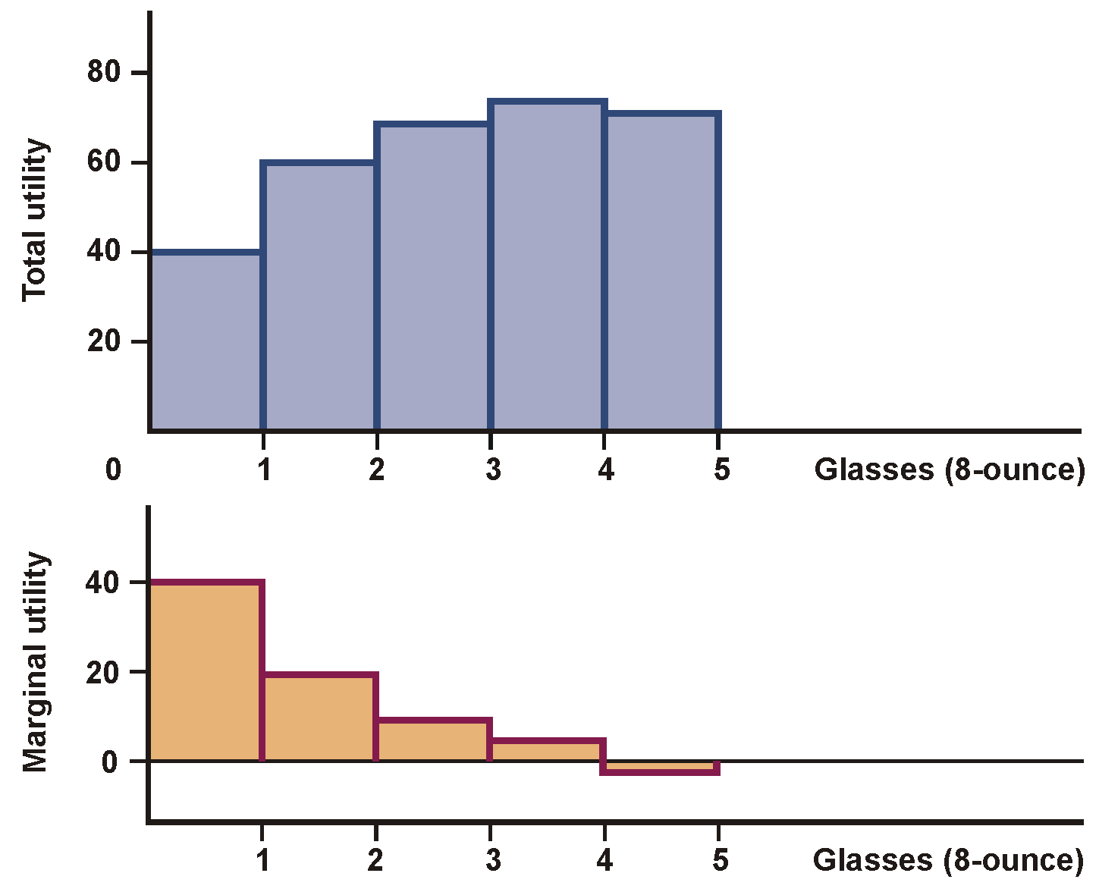
Total and Marginal Utility

Slide 21
Law of Diminishing Marginal Utility
Exceptions:
# Money
# Hobbies and Rare Things
# Liquor and Music
# Things of Display
Importance:
Basis of Law of Demand
Basis of ‘Why Demand Curve slopes downward’

